Slide 1
Emotional literacy and emotion coaching – a very brief introduction
Dr Eleanor Garrett, Educational Psychologist
Notes:
1 min
Will talk about understanding big emotions and things we can do to develop children’s understanding of their own emotions and ways to manage them. Will briefly introduce emotion coaching as one tool

Slide 2
What is emotional literacy and why is it important?
the ability to understand and express feelings.
having self-awareness and recognition of one's own feelings and knowing how to manage them
Emotions influence our attention, memory, learning, decision making, and relationships.
Notes:
Emotional regulation is learnt from experience and role models
Adults have a role in guiding and developing emotional regulation and understanding

Slide 3
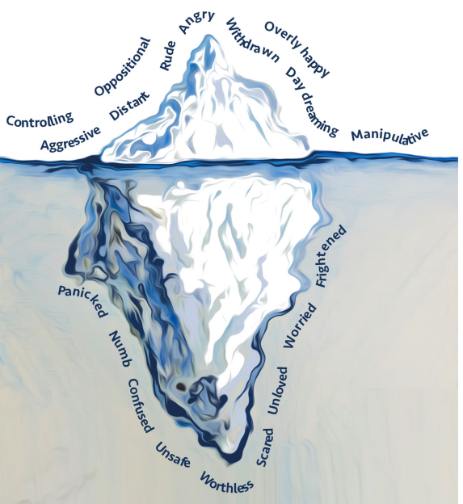
Behaviour as communication
Below the surface: Hidden needs, what someone is feeling
Notes:
It helps to see behaviour as a form of communication. What we see on the surface (someones actions) is actually telling a story about how they feel on the inside or what is happening for them below the surface.
For example, Jay might have flipped the table- below the surface what we didn’t see was that there were bright lights in the classroom making him feel overwhelmed, the teacher didn’t pick him and he felt unloved and rejected, he heard the noise of a closing door which triggered a fight/flight response as at home, this is the noise he hears before his Dad hurts his Mum at home.
We need to try and understand what is beneath the surface to better understand and respond to the behaviour.
Thinking of behaviour as communication is important because (Triesman, 2017):
It can help us think about the most appropriate response/intervention
Reminds us that behaviour is not personable
Prevents the young person from becoming negatively labelled

Slide 4
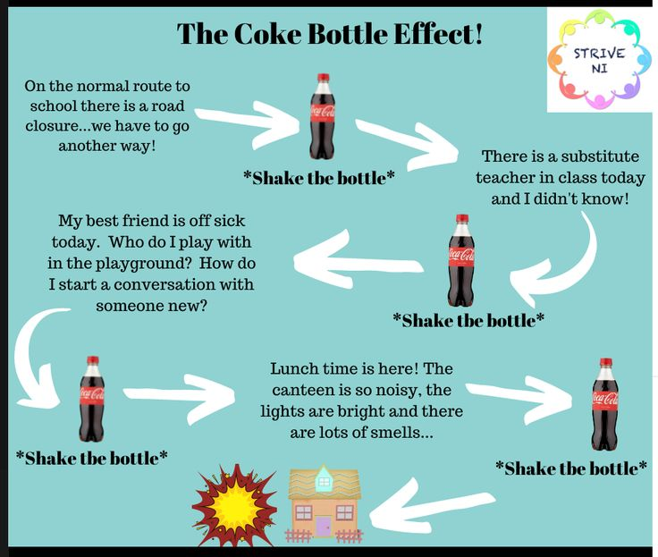
Notes:
In case you don’t know what the coke bottle effect is, here’s a little summary. Think of your child as a coke bottle. As they go through the day the bottle gets more and more shaken, with the pressure building up. Anything from getting dressed to sitting in a classroom to breaktimes increases the child’s stress and anxiety.
They hold is all together whilst at school and that takes a lot of effort. Then you pick them up from school and bang! All the coke is released from the bottle at the same time and it makes one almighty mess.

Slide 5
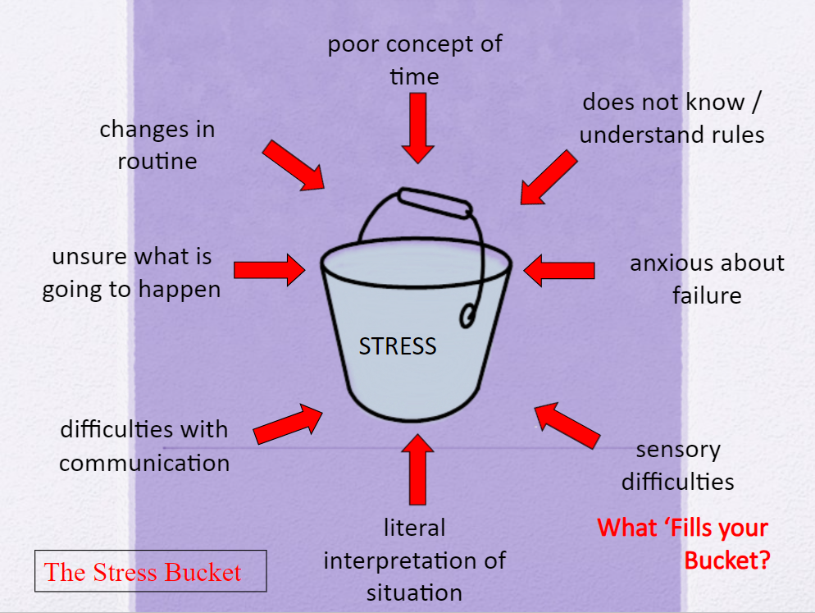
Emotional regulation & neurodiveristy
Autistic children and those with ADHD often find it more challenging to regulate their emotions than others.
There’s also aspects of the environment that they will be processing differently which can lead to feelings of overwhelm.
Notes:
Emotional literacy is important for all children – some may have additional difficulties with managing their emotions
Stress bucket model – used in this example to explain increased feelings of overwhelm for children with autism – however can consider the metaphor of a stress bucket getting filled up by multiple factors and apply it any child that is struggling to regulate their emotions

Slide 6
Emotion coaching -What can we do to help?
Emotion coaching is a communication tool that uses moments of emotion to guide and teach a child
Considers what the feeling, needs, and emotions are behind a behaviour.
It enables us to potentially diffuse and de-escalate situations.
Emotion coaching helps children to feel seen, appreciated and cared for.
Accepts all emotions as normal and healthy

Slide 7
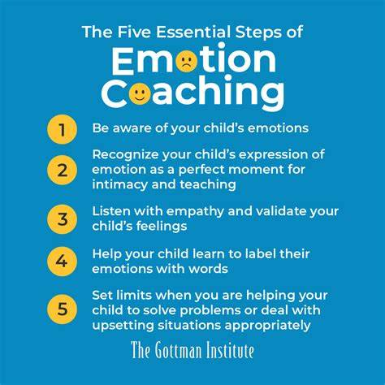
Notes:
American Psychologist John Gottman,

Slide 8
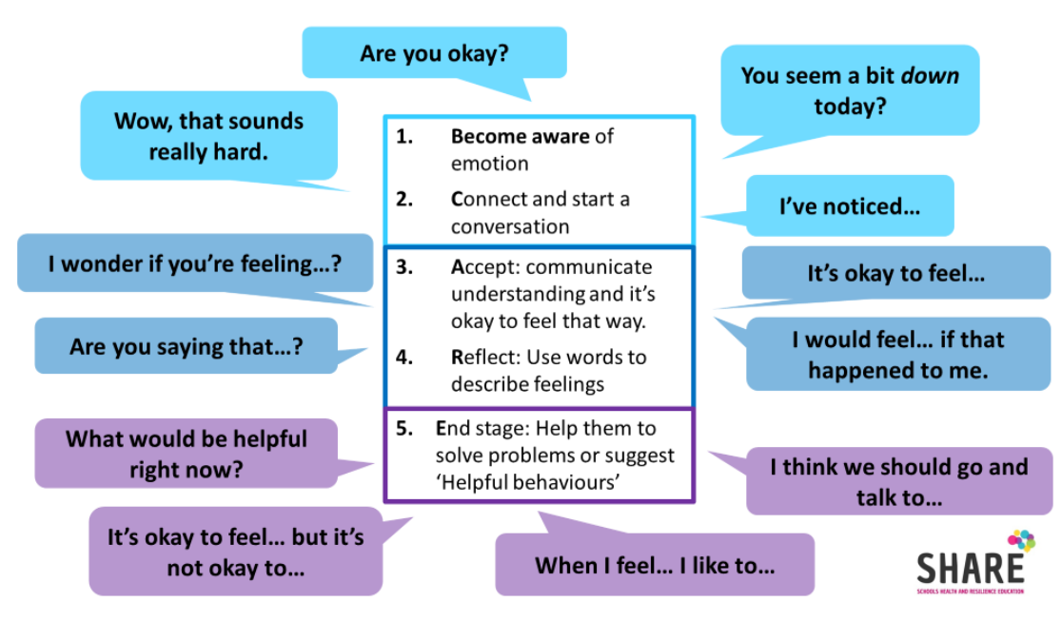

Slide 9
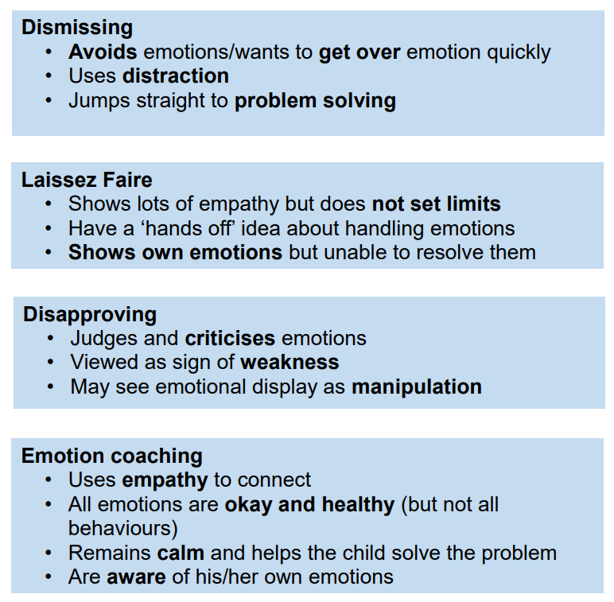
Communication styles
Inside Out - Emotional Intelligence (youtube.com))
Notes:
Which communication style do you use? Emotion coaching is a style of communication. Most people use a mix of styles, and most are well intentioned, but one is usually more dominant than the others, having a greater impact.

Slide 10
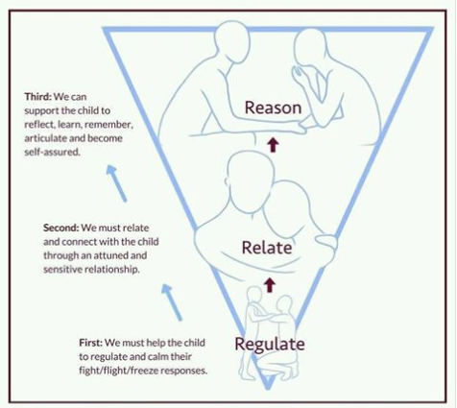
Notes:
Helpful model to share

Slide 11

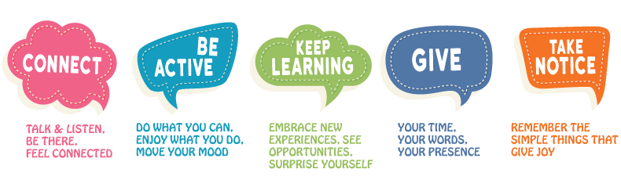
Notes:
Should probably mention first!
Emotions are contagious

Slide 12
Any questions?

