Slide 1

Westbury Park
What do we offer to support children with their social and emotional needs?

Slide 2
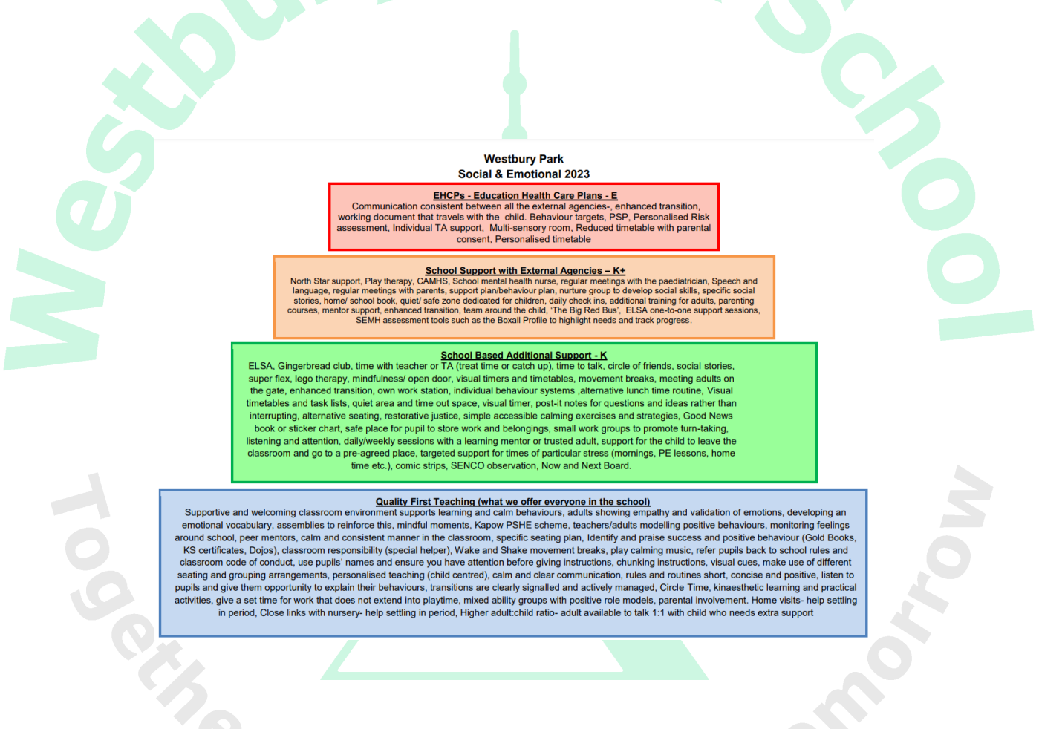
Our Provision Map for Social, Emotional and Mental Health Needs

Slide 3
What to do if you do have concerns
These are key staff in school you can speak to:
Class teacher – generally the first point of contact for all queries
SENDCO – Claire Reed (working days Tuesday and Wednesday) ms.reed@westburyparkschool.co.uk
Deputy Head – Helen Clark – responsibility for pastoral and mental health needs, also links in with Sian McVeigh, Play Therapist (private service)

Slide 4
Further information and sources of support
https://www.westburyparkschool.com/special-educational-needs-sen
https://www.bristol.gov.uk/residents/social-care-and-health/children-and-families/support-for-parents-and-carers/parenting-courses-currently-running-in-bristol
The Incredible Years: for parents and carers of children aged 3 to 10 years with challenging behaviour
Parents Plus Adolescents Programme: for parents and carers of children and teenagers aged 10 to 17 years
Timid to Tiger: for parents and carers of children aged 3 to 12 years with anxiety
Non-Violent Resistance or NVR: for parents or carers of children aged 8 to 17 years with violent, controlling or self-destructive behaviours
Parents Plus Parenting When Separated Programme: for parents who're preparing for, going through, or have gone through a separation or divorce

